Slide 1
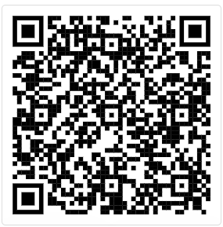
Interested in the US Hourly SAP Phase 2 Program?
Update your Home Contact Information
As part of the preparation for the upcoming US Hourly SAP Phase 2 Program, we kindly recommend that you review and update your Home Contact Information in Workday.
It is important to verify your Home Address and add an Email address to receive communication.
By ensuring that your contact information is accurate and up to date, you can stay informed and receive important updates regarding the program.
Note: Application Period is from Nov 22, 2024 to January 5, 2025
SCAN THE QR CODE
TO GET STARTED
(Via Workday)

Slide 2
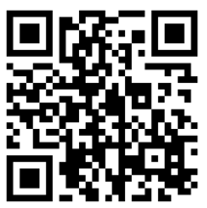
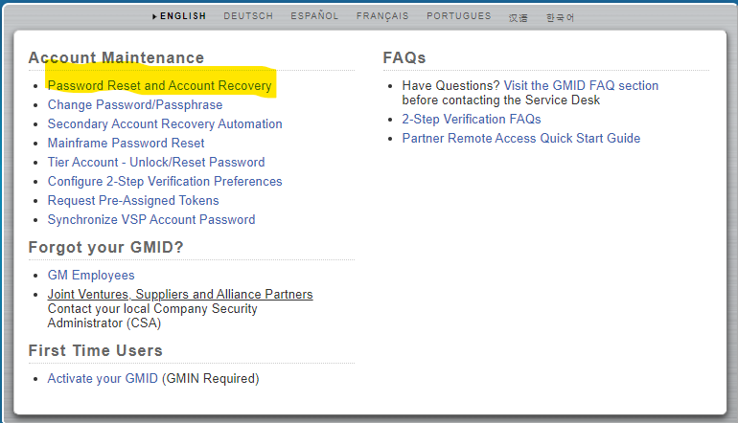
Trouble Logging into Workday?
Scan the QR code below if you are having trouble logging into Workday.
You can recover or change your password from GMID.GM.com.
Click password reset and account recovery
SCAN THE QR CODE
TO GET STARTED
(Via GMID.GM.com)
For additional support call GMNA People services: 1-866-245-5957

